Slide 1
UNIVERSITY OF LAGOS
DEPT OF GEOGRAPHY
B.Sc. Meteorology and Climate Science
An Overview of MET 212:
Codes & Observation and Plotting
Instructors:
Prof. S. Odunuga
Dr. S. K. Muyiolu

Slide 2
OUTLINE
BASIC METEOROLOGICAL VARIABLES
WIND,
VISIBILITY,
WEATHER,
TEMPERATURE
PRESSURE, ETC.

Slide 3
2. Few derived variables QFF,
QNH,
Dew point etc.

Slide 4
3. Simple meteorological instruments Thermometer,
wind vane,
sunshine recorder,
hygrometer
Rainguages, etc.

Slide 5
4. Autographic Instruments:- Barograph,
Thermograph,
Hygrograph,
Pressure – dine anemograph, etc.

Slide 6
5. Simple care and maintenance of the instruments. e.g
Thermometers, autographic etc

Slide 7
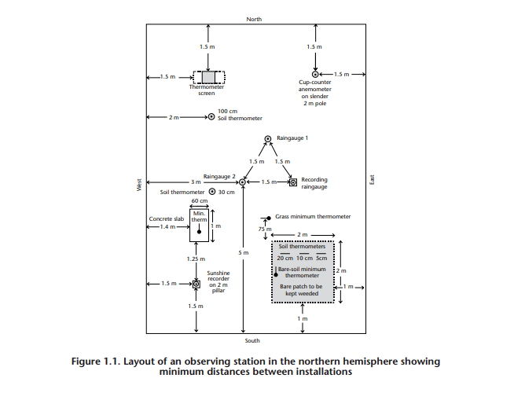

Slide 8
6. Features of the Stevenson screen and meteorological enclosure (site, location, exposures of instruments et. Rainguage etc.)

Slide 9
7. WMO approved International Codes (AAXX),
(PPAA & PPBB) and
(TTAA), (TTBB).

Slide 10
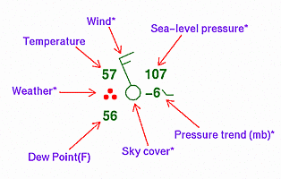
8. Ease of converting from plotting to codes to observation and vice versa.

Slide 11
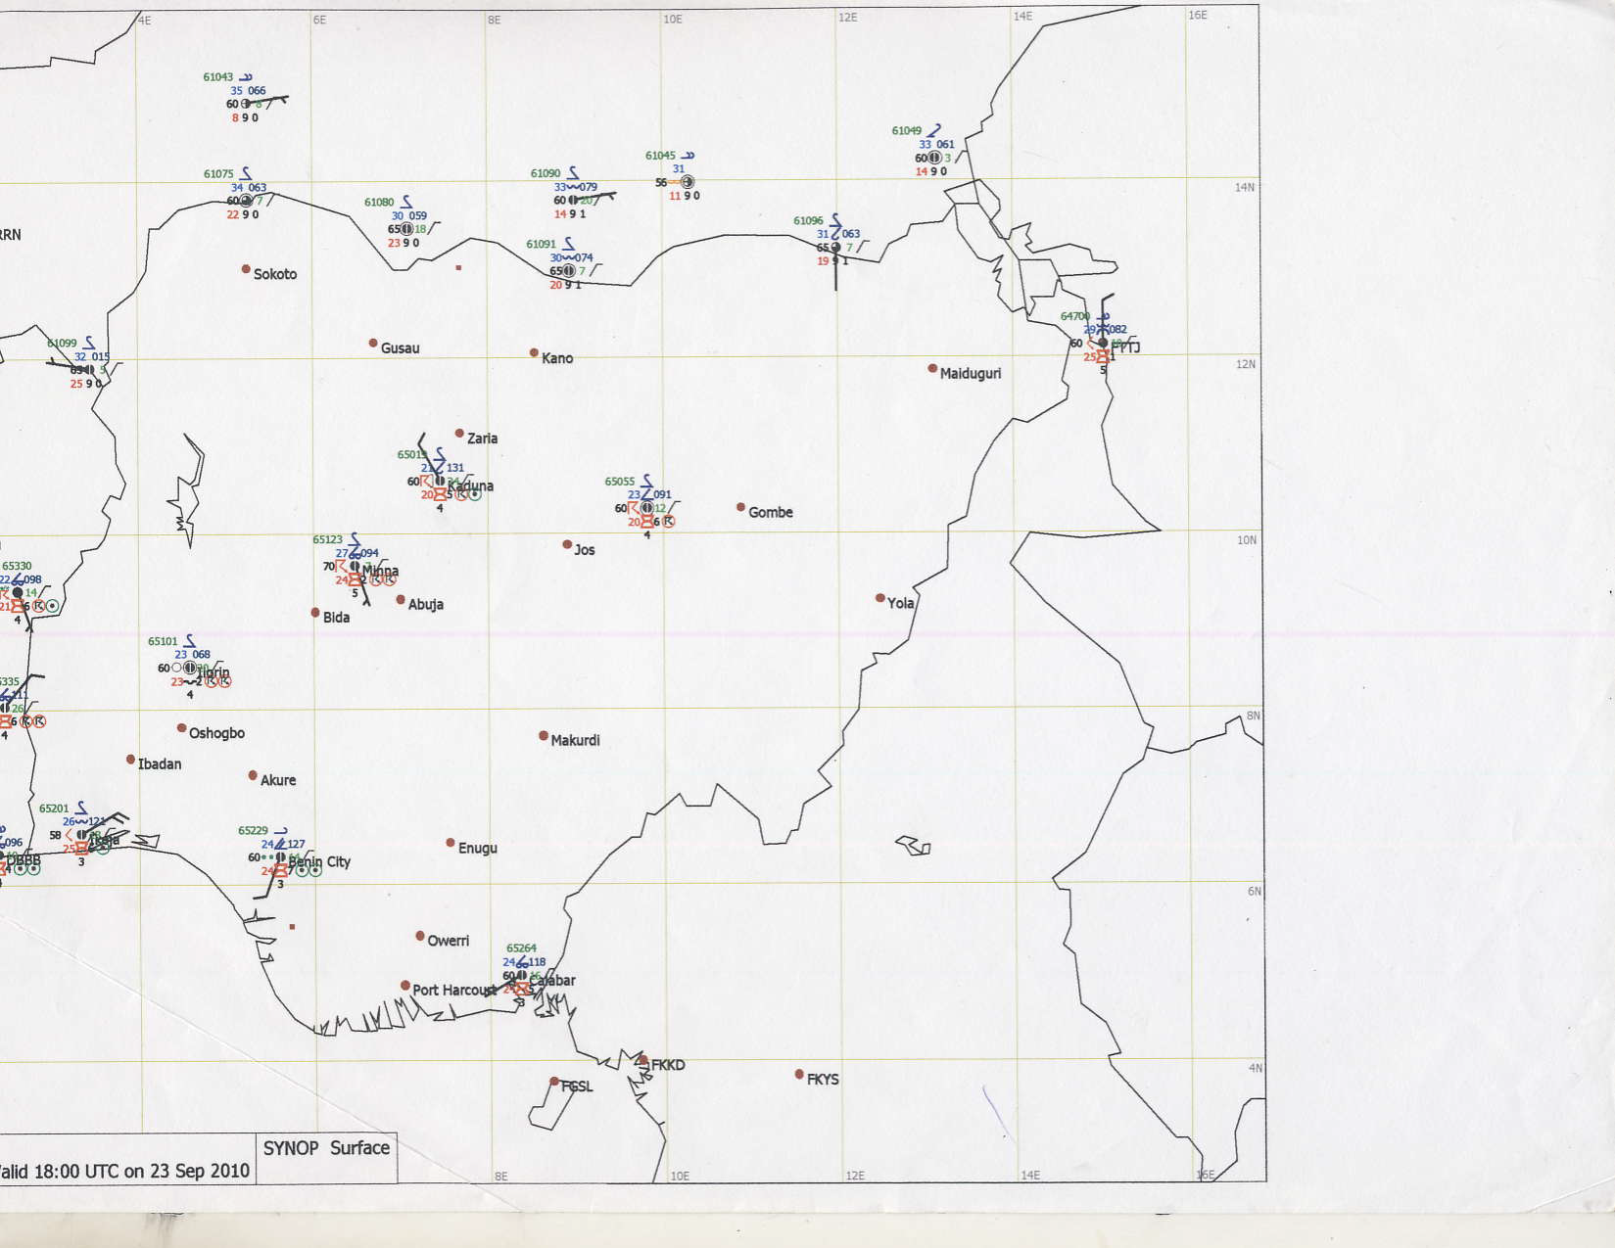
9. Plotting of codes on meteorological weather charts.

Slide 12
Questions ?

